Slide 1
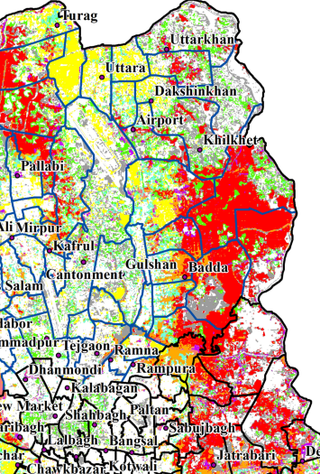
Measuring Seasonal Variation of Land Use and Land Cover Indices and Its Impact on Land Surface Temperature in Dhaka, Bangladesh
Sharmin Siddika
OCS 4001

Slide 2
Introduction
Rapid land use land cover change is a leading cause of climate change, particularly through increased temperatures (Steeneveld et al., 2018).
Rising land surface temperatures (LST) impact urban areas by reducing comfort, worsening air and water quality, increasing mortality, and causing economic losses (Kumar, Mondal, and Pham 2021).
Considering this, the objective of the study is to identify seasonal and spatial distribution of LULC indices (NDVI, NDBAI, MNDWI, and NDBI) and its impact on LST.

Slide 3
Research Questions
How do seasonal Land Cover dynamics influence LST in Dhaka?
What changes have occurred in built-up areas, vegetation, and LST over time?
How are LULC indices correlated with LST?
What strategies can mitigate LST hotspots and support ecological balance?

Slide 4
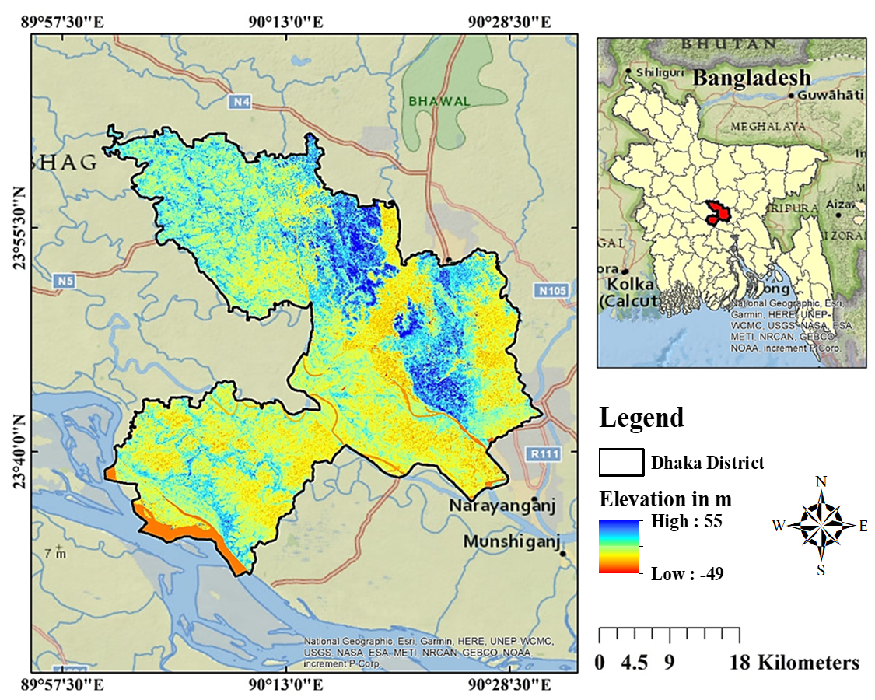
Why Dhaka as study area??
Rapid population growth and migration.
Unplanned urbanization.
Figure 1: Study Area Map of Dhaka Metropolitan Area, Year 2024

Slide 5
Methodology (Methodological Framework)
Data Collection
Landsat Data
Normalized difference built-up index (NDBI)
Modified Normalized Difference Water Index (MNDWI)
Image
Processing
Land Surface Temperature (LST)
Normalized Difference Bareness Index (NDBaI)
Normalized difference vegetation index (NDVI)
Nexus between LULC indices and LST
Correlation Analysis
Using Python
Linear regression
Pearson’s correlation coefficient
Spearman’s rank correlation coefficient
Discussion/ Conclusion
(Grigoraș & Urițescu, 2019, Isaac, 2018)

Slide 6
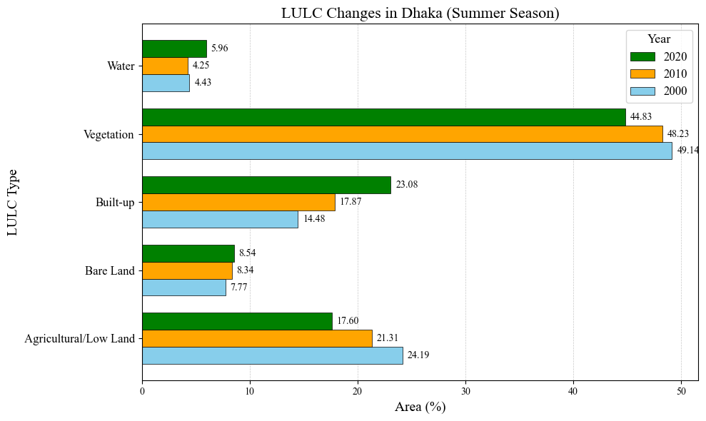
Analysis and Results
Transition | Percentage
Agriculture - Built-up | 6.38%
Vegetation - Built-up | 7.03%
Vegetation - Bare Land | 6.53%
Waterbody - Built-up | 1.03%
Bare land - Built-up | 5.38%
Figure 2. Land Use Land Cover change detection

Slide 7
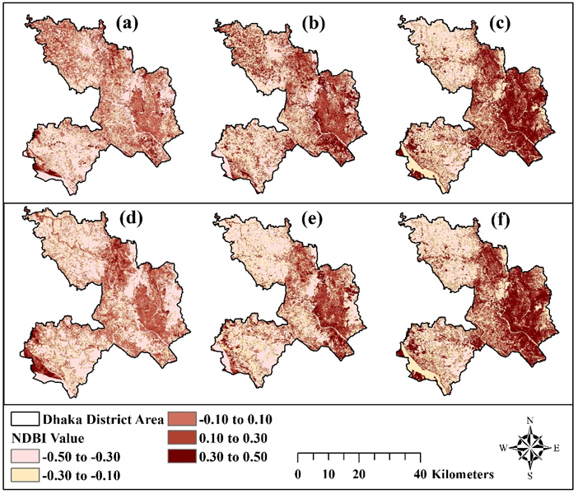
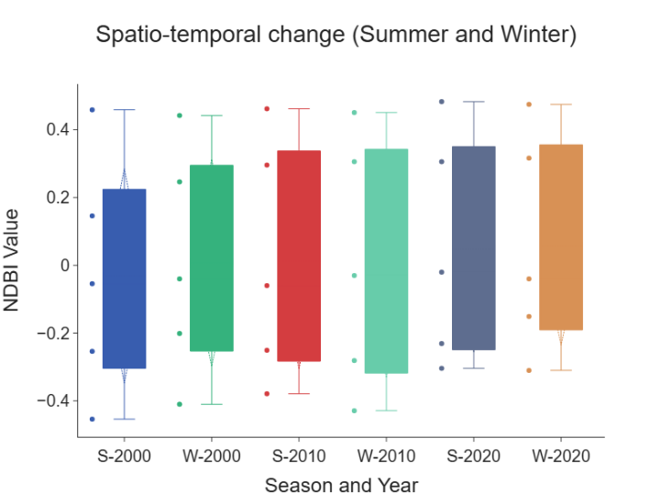
Seasonal variability and intensity of NDBI, 2000 – 2020
Median NDBI values rise gradually.
Fewer extreme outliers and a more compact range, indicating consistent growth.
Figure 3: NDBI profile of the study area during winter season (a) 2000 (b) 2010 (c) 2020 and summer season (d) 2000 (e) 2010 (f) 2020.

Slide 8
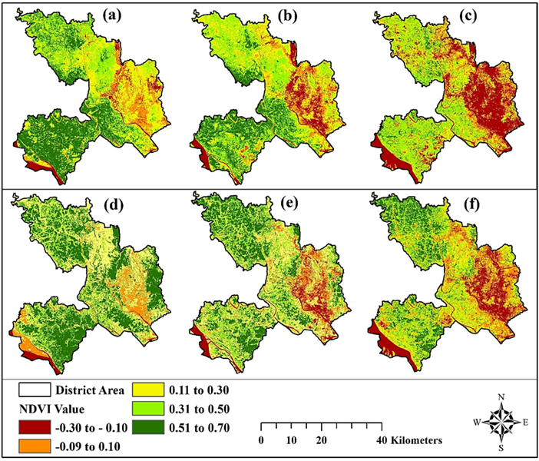
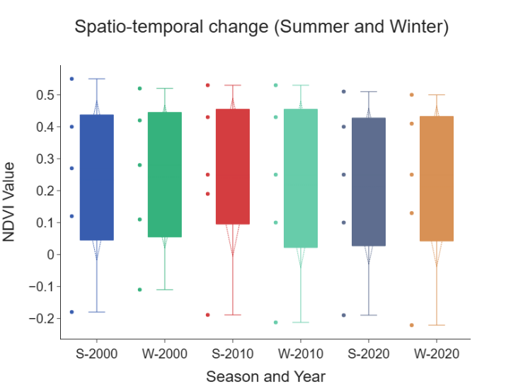
Seasonal variability and intensity of NDVI, 2000 – 2020
Summer season- positive values clustered in a smaller range, less variability.
Winter season- greater variability in vegetation condition.
Figure 4: NDVI profile of the study area during winter season (a) 2000 (b) 2010 (c) 2020 and summer season (d) 2000 (e) 2010 (f) 2020.

Slide 9
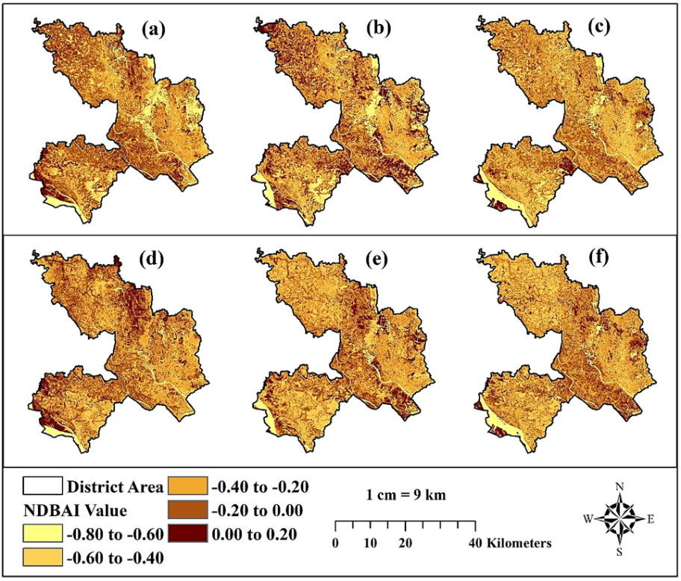
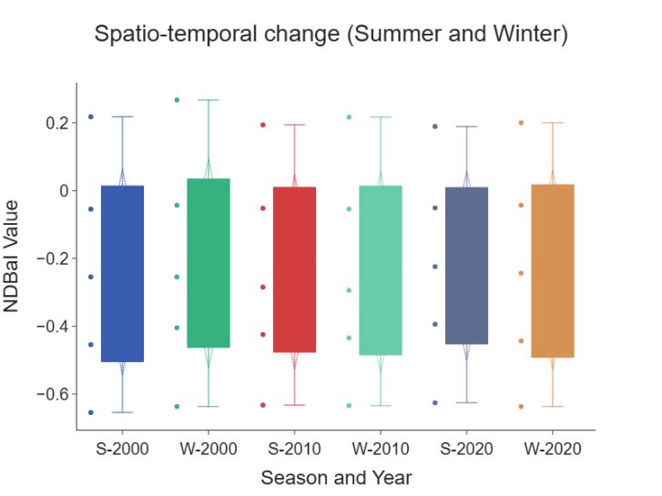
Seasonal variability and intensity of NDBaI, 2000 – 2020
Urban development has become more widespread.
The diversity of NDBaI values have decreased, meaning fewer areas are exhibiting low urbanization levels.
Figure 5: NDBaI profile of the study area during winter season (a) 2000 (b) 2010 (c) 2020 and summer season (d) 2000 (e) 2010 (f) 2020.

Slide 10
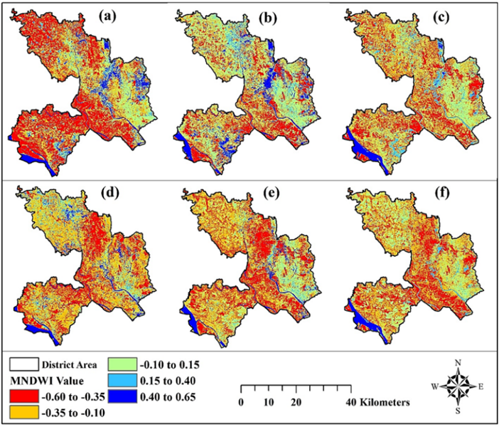
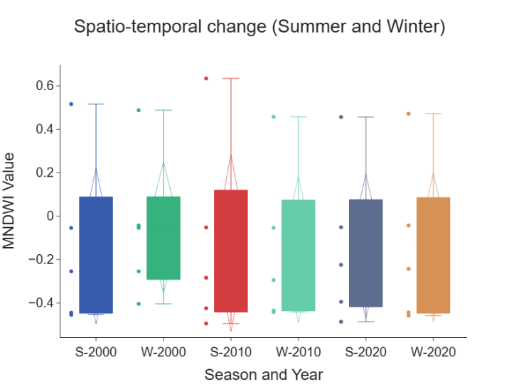
Seasonal variability and intensity of MNDWI, 2000 – 2020
The median value is negative.
Indicating relatively low water content.
Figure 6: MNDWI profile of the study area during winter season (a) 2000 (b) 2010 (c) 2020 and summer season (d) 2000 (e) 2010 (f) 2020.

Slide 11
Observed seasonal LST variations during the study period
LST ranges | 2000 |  | 2010 |  | 2020
 | Winter | Summer | Winter | Summer | Winter | Summer
 | Area in %
15 – 20⁰C | 61.48 | 0 | 30.21 | 0 | 42.60 | 0
20 – 25⁰C | 38.02 | 7.85 | 68.50 | 6.40 | 52.85 | 9.35
25 – 30⁰C | 0.50 | 51.15 | 1.29 | 33.35 | 4.55 | 33.65
30 – 35⁰C | 0 | 28.50 | 0 | 41.00 | 0 | 20.50
35 – 40⁰C | 0 | 12.50 | 0 | 19.25 | 0 | 36.50

Slide 12
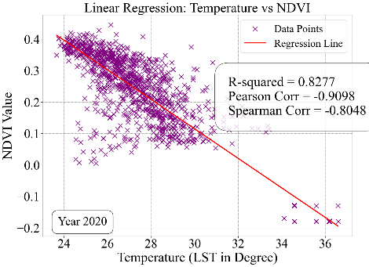
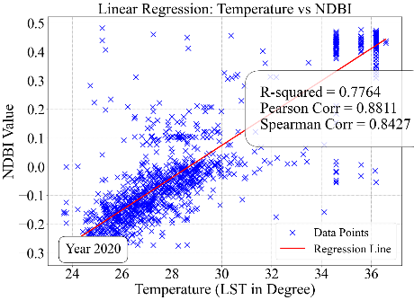
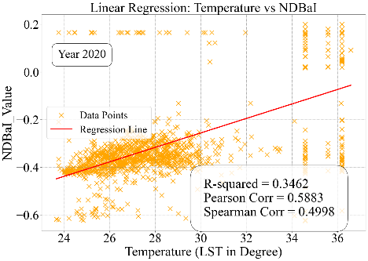
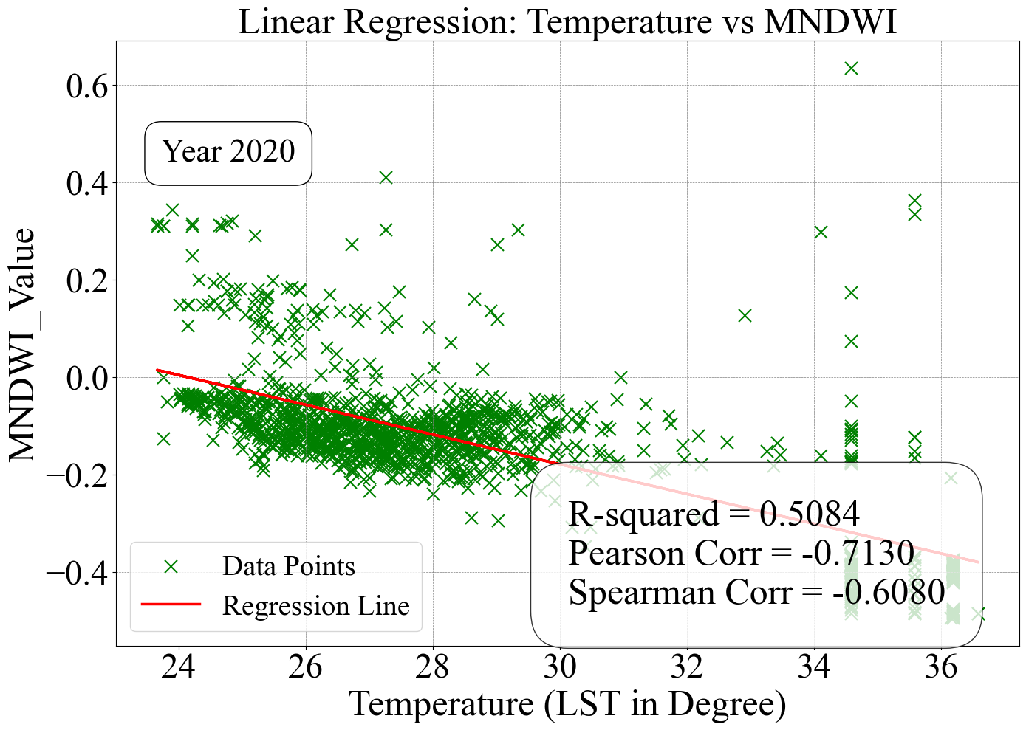
Regression Analysis
Figure 7: Correlation between the summer season land use indices and LST during year 2020

Slide 13
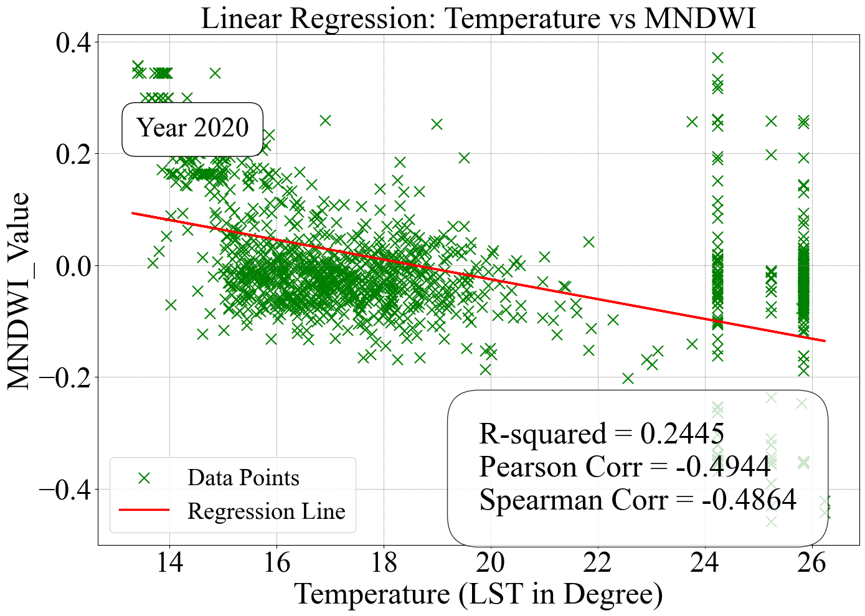
Regression Analysis
Figure 8: Correlation between the winter season land use indices and LST during year 2020

Slide 14
Discussion and Conclusion
Increase in built-up areas and the decrease in vegetation cover, is a leading cause of higher land surface temperature.
Offers valuable insights for strategic urban development and vegetation conservation.
Limitation
Inaccuracy in detecting certain changes, such as waterbody fluctuations in year 2020.

Slide 15
References
Grigoraș, G., & Urițescu, B. (2019). Land Use/Land Cover changes dynamics and their effects on Surface Urban Heat Island in Bucharest, Romania. International Journal of Applied Earth Observation and Geoinformation, 80, 115–126. https://doi.org/10.1016/j.jag.2019.03.009
Isaac, E. (2018). Test for Significance of Pearson’s Correlation Coefficient ().
Kumar, M., Mondal, I., & Pham, Q. B. (2021). Monitoring forest landcover changes in the Eastern Sundarban of Bangladesh from 1989 to 2019. Acta Geophysica, 69(2), 561–577. https://doi.org/10.1007/s11600-021-00551-3
Steeneveld, G.-J., Klompmaker, J. O., Groen, R. J. A., & Holtslag, A. A. M. (2018). An urban climate assessment and management tool for combined heat and air quality judgements at neighbourhood scales. Resources, Conservation and Recycling, 132, 204–217. https://doi.org/10.1016/j.resconrec.2016.12.002

